Slide 1
Feature engineering
Overview
Feature Selection
Filter methods
Wrapper methods
Embedded methods
Feature Extraction
Principal component analysis (PCA)
Linear Discriminant analysis (LDA)
Singular value decomposition (SVD)
Data Science Overview

Slide 2
Feature engineering in real life
Typically a cycle
1 design a set of features
2 run an experiment and analyze the results on a validation dataset
3 change the feature set
4 go to step 1
Don’t expect more elegant answers today itself !!!
Because it does not exist!
Notes:
Why is everyone talking about DATA SCIENCE? Last 5 years of trend on google search gives a clear picture. Industry/companies/organization/academic institutions are searching more and more of “data science” and “python”.
Am sure, all of you have heard about “data science” and/or “python/R/Spark/Hadoop/Kafka/.. Etc” and have some idea about these terms.
History of DS – it goes back to early 2000s .. 2004 when Google’s search engine was making a huge impact on the way we surfed the web. The reason for big data projects of Google is apparently linked to our increasing dependence on ‘data driven way of living’
When people talk of “data science” , they are in fact talking of companies like Google, Facebook, Twitter, Instagram etc.

Slide 3
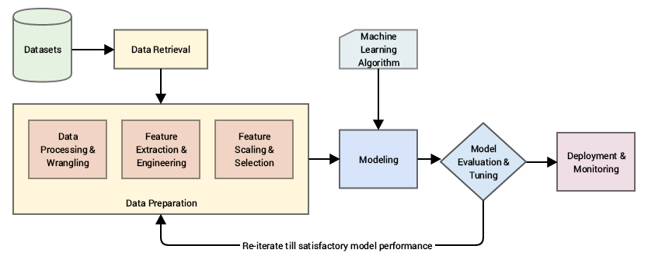
A standard machine learning pipeline
Feature Engineering is an art as well as a science and this is the reason Data Scientists often spend 70% of their time in the data preparation phase.
Based on CRISP-DM industry standard process model
Feature Engineering

Slide 4
motivation
“Coming up with features is difficult, time-consuming, requires expert knowledge. ‘Applied machine learning’ is basically feature engineering.”
— Prof. Andrew Ng.
This basically reinforces data scientists spend close to 80% of their time in engineering features which is a difficult and time-consuming process, requiring both domain knowledge and mathematical computations.
“Feature engineering is the process of transforming raw data into features that better represent the underlying problem to the predictive models, resulting in improved model accuracy on unseen data.”
— Dr. Jason Brownlee
feature engineering being the process of transforming data into features to act as inputs for machine learning models such that good quality features help in improving the overall model performance.
Features are also very much dependent on the underlying problem..

Slide 5
motivation
“At the end of the day, some machine learning projects succeed and some fail. What makes the difference? Easily the most important factor is the features used.”
— Prof. Pedro Domingos
“The algorithms we used are very standard for Kagglers. …We spent most of our efforts in feature engineering. … We were also very careful to discard features likely to expose us to the risk of over-fitting our model.”
— Xavier Conort

Slide 6
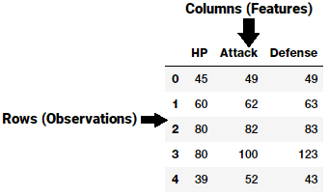
Understanding Features
A feature is typically a specific representation on top of raw data, which is an individual, measurable attribute, typically depicted by a column in a dataset.
Considering a generic two-dimensional dataset, each observation is depicted by a row and each feature by a column, which will have a specific value for an observation.

Slide 7
Understanding Features
each row typically indicates a feature vector
entire set of features across all the observations forms a two-dimensional feature matrix also known as a feature-set.
This is akin to data frames representing 2-dimensional data.
Typically machine learning algorithms work with these numeric matrices or tensors
most feature engineering techniques deal with converting raw data into some numeric representations which can be easily understood by these algorithms.

Slide 8
Types of features
Features can be of two major types based on the dataset.
Inherent raw features are obtained directly from the dataset with no extra data manipulation or engineering.
Derived features are usually obtained from feature engineering, where we extract features from existing data attributes.
A simple example would be creating a new feature “Age” from an employee dataset containing “Birthdate” by just subtracting their birth date from the current date.

Slide 9
Curse of dimensionality
"As the number of features or dimensions grows, the amount of data we need to generalize accurately grows exponentially."
- Charles Isbell, Professor and Senior Associate Dean, School of Interactive Computing, Georgia Tech

Slide 10
Curse of dimensionality
Datasets typically high dimensional
Vision – 10⁴ pixels, Text – 10⁶ words
True dimensionality often much lower
20x20 bitmap : {0, 1}⁴⁰⁰ possible events
We will never most of these events
Actual digits : tiny fraction of all events
Why high dimensionality is a problem?
Machine learning methods are statistical in nature
Count observations, number of tokens, decision trees (count/probabilities)
Number of +ves, -ves

Slide 11
Dealing with high dimensionality
Use of domain knowledge
Dimensionality reduction
GOAL : Try to preserve as much structure in the data as possible
Feature selection
Pick subset of the original dimensions X1, X2, X3, X4 …. Xn
Feature extraction
Construct a new set of dimensions
Linear combinations of original

Slide 12
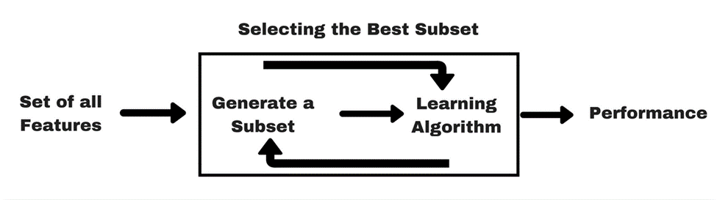
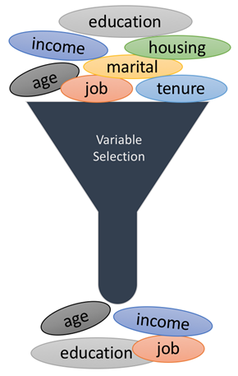
Feature selection
also called variable selection or attribute selection.
It is the automatic selection of attributes in data (such as columns in tabular data) that are most relevant to the predictive modeling problem.
feature selection returns a subset of the features
E.g. text mining, bio/pharma data
A search technique for proposing new feature subsets, along with an evaluation measure (scores)
is computationally intensive

Slide 13
Benefits of feature selection
Feature selection techniques are used for 4 reasons:
simplification of models to make them easier to interpret by researchers/users
shorter training times
to avoid the curse of dimensionality
enhanced generalization by reducing overfitting, (formally, reduction of variance)
An optimized set of selected features using a given algorithm may or may not perform equally well with a different algorithm.
features using logistic regression, for example, there is no guarantee that these same features will perform optimally if tried out using K-nearest neighbors, or an SVM.

Slide 14
Feature selection -Basic approaches:
filter - use N most promising features according to ranking resulting from a proxy measure, e.g. from
mutual information
Pearson correlation coefficient
wrapper - search through the space of subsets, train a model for current subset, evaluate it on held-out data, iterate...
simple greedy search heuristics:
forward selection - start with an empty set, gradually add the “strongest” features
backward selection - start with the full set, gradually remove the “weakest” features
computationally expensive
embedded methods - feature selection is a part of model construction (REGULARIZATION – Ridge, Lasso and ElasticNet algorithms)

Slide 15
Filter method
Feature selection is the process of selecting those attributes in the dataset that are most relevant
apply a statistical measure to assign a score to each feature.
feature columns with the best scores are used in building the model
The methods are often univariate and consider the feature independently

Slide 16
Filter methods - types
Type
information value | Very useful in feature selection
Univariate feature selection | Univariate feature selection works by selecting the best features based on univariate statistical tests. (SelectKBest removes all but the k highest scoring features SelectPercentile removes all but a user-specified highest scoring percentage of features For regression: f_regression, mutual_info_regression For classification: chi2, f_classif, mutual_info_classif
fisher score
correlation threshold | Co-relation between X and y. Features with highest co-relation is selected Co-relation matrix ( 0 -1)
variance threshold | removes features with variation below a certain cutoff. By default, it removes all zero-variance features Scale before applying Check CORR between X and y first

Slide 17
Variance Threshold
removes all features whose variance doesn’t meet some threshold. (remove all below the variance)
By default, it removes all zero-variance features, i.e. features that have the same value in all samples.
The idea is when a feature doesn’t vary much within itself, it generally has very little predictive power.
Variance Threshold doesn’t consider the relationship of features with the target variable.
variance is dependent on scale, you should always normalize your features first. ***
Strengths | Weaknesses
intuition: features that don't change much also don't add much information | manually set or tune a variance threshold, could be tricky
Apply at the start of your modeling process. | starting with a conservative (i.e. lower) threshold.

Slide 18
correlation Threshold
Correlation thresholds remove features that are highly correlated with others (i.e. its values change very similarly to another's). These features provide redundant information.
For example, if you had a real-estate dataset with 'Floor Area (Sq. Ft.)' and 'Floor Area (Sq. Meters)' as separate features, we can safely remove one of them.
Which one should you remove?
first calculate all pair-wise correlations. Then, if the correlation between a pair of features is above a given threshold, remove the one that has larger mean absolute correlation with other features.
Strengths | Weaknesses
intuition: similar features provide redundant information. Some algorithms are not robust to correlated features, so removing them can boost performance. | manually set or tune a corr threshold, could be tricky
Apply at the start of your modeling process. | starting with a conservative (i.e. lower) threshold.

Slide 19
Chi-Squared Test
When input variables are categorical, we can use statistical tests to determine whether the output variable is dependent or independent of the input variables.
The Pearson’s chi-squared statistical hypothesis is an example of a test for independence between categorical variables.
Chi-Squared test is a statistical hypothesis test that assumes (the null hypothesis) that the observed frequencies for a categorical variable match the expected frequencies for the categorical variable.
The test calculates a statistic that has a chi-squared distribution,
The chi square tests are used most often to analyze data consists of counts and frequencies.
Developed in early 1900

Slide 20
Selectkbest - Interpretation
It takes as a parameter a score function, which must be applicable to a pair (X, y).
The score function must return an array of scores, one for each feature X[:,i] of X
SelectKBest then simply retains the first k features of X with the highest scores.
So, for example, if you pass chi2 as a score function, SelectKBest will compute the chi2 statistic between each feature of X and y (assumed to be class labels).
A small value will mean the feature is independent of y.
A large value will mean the feature is non-randomly related to y and so likely to provide important information.
Only k features will be retained

Slide 21
Information Value
The advantages are:
Handles missing values
Handles outliers
The transformation is based on logarithmic value of distributions. This is aligned with the logistic regression output function
No need for dummy variables
By using proper binning technique, it can establish monotonic relationship (either increase or decrease) between the independent and dependent variable

Slide 22
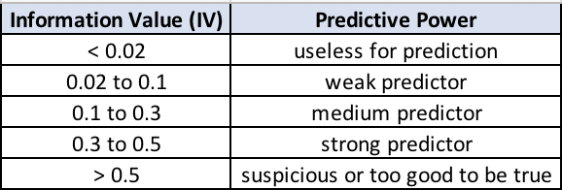
Information value table

Slide 23
Wrapper method
measure the “usefulness” of features based on the classifier performance
Wrapper methods consider the selection of a subset of features as a search problem, where different combinations are prepared, evaluated and compared to other combinations.
Evaluated jointly
A predictive model is used to evaluate a combination of features and assign a score based on model accuracy.
The search process may be methodical such as a best-first search,
it may stochastic such as a random hill-climbing algorithm, or
it may use heuristics, like forward and backward passes to add and remove features.

Slide 24
wrapper methods - how
Type
Subset selection
Step Forward feature selection - SFS | Starts with a feature, select best feature Select all possible combinations computationally expensive May take too long Too infeasible
Step backward feature selection - SBS | Starts with all feature, Remove features to optimally find the required feature set computationally expensive May take too long Too infeasible
Recursive Feature elimination | computationally less complex
with a dataset of accommodating size and dimensionality, such an approach may well be the best possible approach.

Slide 25
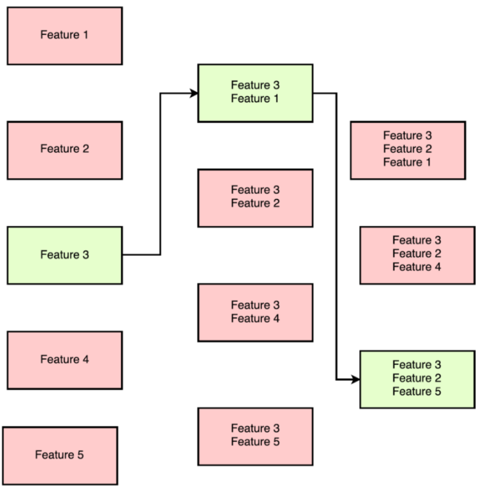
Forward Selection method - example
For data with n features,
->On first round ‘n’ models are created with individual feature and the best predictive feature is selected.
->On second round, ‘n-1’ models are created with each feature and the previously selected feature.
->This is repeated till a best subset of ‘m’ features are selected.

Slide 26
Step forward feature selection
starts with the evaluation of each individual feature
best performing
What's the "best?"
That depends entirely on the defined evaluation criteria (AUC, prediction accuracy, RMSE, etc.).
Next, all possible combinations of the that selected feature and a subsequent feature are evaluated, and a second feature is selected, and so on, until the required predefined number of features is selected

Slide 27
Step backward feature selection
Step | Descp | Col A | Col B | Col C | Col D | ML stats
1 | Start with all columns | A | B | C | D | 79%
2 | Run with all the subsets | A | B | C |  | 75
 |  |  | B | C | D | 72
 |  | A |  | C | D | 81
 |  | A | B |  | D | 67
3 |  | A |  | C |  | 76
 |  |  |  | C | D | 83
 |  | A |  |  | D | 77

Slide 28
Recursive Feature elimination
RFE is computationally less complex using the feature weight coefficients (e.g., linear models) or feature importance (tree-based algorithms) to eliminate features recursively,
whereas SFSs eliminate (or add) features based on a user-defined classifier/regression performance metric.

Slide 29
Recursive Feature elimination
Step | Descp | Col A | Col B | Col C | Col D | ML stats
1 | Start with all columns | A | B | C | D | Calculate the score {coeff or feature importance} for each feature Remove the feature with lowest score
2 | Run with all the subsets |  | B | C | D | Calculate the score {coeff or feature importance} for each feature Remove the feature with lowest score
3 | Final Selection |  | B | C

Slide 30
Embedded Methods
Embedded methods learn which features best contribute to the accuracy of the model while the model is being created.
The most common type of embedded feature selection methods are regularization methods.
Regularization methods are also called penalization methods that introduce additional constraints into the optimization of a predictive algorithm (such as a regression algorithm) that bias the model toward lower complexity (fewer coefficients).
Examples of regularization algorithms are the LASSO, Elastic Net and Ridge Regression.

Slide 31
embedded methods - how
Type
Regularization | Controls the value of the parameter. Not so important variables are given low weight
Lasso regression
Ridge regression
Shrinkage methods
Inbuilt variable selection methods (without select/ reject feature)

Slide 32
Summary of 3 types of feature selection methods
Filter methods:
information gain
Univariate feature selection
fisher score
correlation coefficient
variance threshold
Wrapper methods:
recursive feature elimination
sequential feature selection algorithms
genetic algorithms
Embedded methods:
L2 (Ridge regression)
L1 (LASSO regression)
ElasticNet
Feature with higher variance may contain more useful information,
compute the variance of each feature,
select the subset of features based on a user-specified threshold. E.g., “keep all features that have a variance greater or equal to x” or “keep the top k features with the largest variance.”
NOT taking the relationship between feature variables or feature and target variables
find the “optimal” feature subset by iteratively selecting features based on the classifier performance.
train and cross-validate our model for each feature subset combination
Computationally intensive
adding a penalty against complexity to reduce the degree of overfitting or variance of a model by adding more bias.

Slide 33
Dimensionality reduction
Linear Discriminant Analysis
Singular value decomposition, Factor Analysis
Principal Component Analysis

Slide 34
PCA PRIMER
Principal Component Analysis (PCA) is a dimensionality reduction technique used to transform high-dimensional datasets into a dataset with fewer variables, where the set of resulting variables explains the maximum variance within the dataset.
PCA is used prior to unsupervised and supervised machine learning steps to reduce the number of features used in the analysis, thereby reducing the likelihood of error and also the computation time.
2 parts to understanding the PCA model
Understand what PCA does? How to use and interpret the results?
Maths behind the PCA

Slide 35
Pca – what does it do?
In dimensionality reduction, we learn a smaller set of variables which describe the data sufficiently well.
Basically mapping the original variables to new variables
In PCA, we are interested to find the directions (components) that maximize the variance in our dataset
So, in this way, the 1st principal component retains maximum variation that was present in the original components.
The variation present in the PCs decrease as we move from the 1st PC to the last one, hence the importance.

Slide 36
Pca – the maths behind it
In PCA the model/function used is a linear combination of the original variables i.e. each new variable is constructed as a linear combination of the original variables
The principal components are the eigenvectors of a covariance matrix, and hence they are orthogonal.

Slide 37
Why pca?
There are 2 aspects of dimensionality reduction with PCA.
The training time of the algorithms reduces significantly with less number of features.
It is not always possible to analyze data in high dimensions, in 2D or 3D
For instance if there are 100 features in a dataset.
Total number of scatter plots required to visualize the data would be 100(100-1)/2 = 4950.
Practically it is not possible to analyze data this way.

Slide 38
Normalization of Features
A feature set must be normalized before applying PCA.
Data expressed in units of Kilograms, Light years, or Millions, the variance scale is huge
PCA is applied on such a feature set, the resultant loadings for features with high variance will also be large.
Principal components will be biased towards features with high variance, leading to false results.
PCA is a statistical technique and can only be applied to numeric data.
categorical features are required to be converted into numerical features before PCA can be applied.

Slide 39
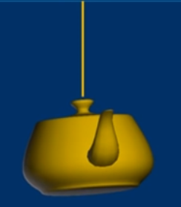

Pca – intuitive
How to take a picture to capture the most information about the teapot?

Slide 40
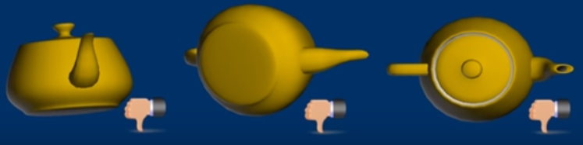


Most people will choose the top view
Why & How?
Because this view provides the most visual information
How do we find this view?
Rotate the teapot !!!

Slide 41
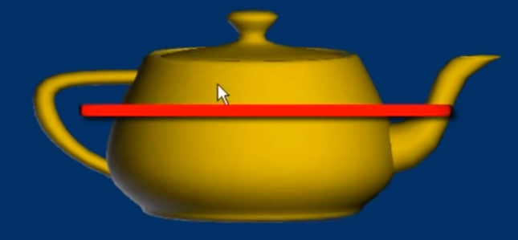
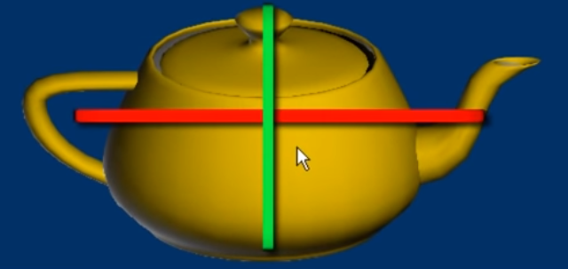
Find the longest axis
First find the axis so that the object has largest extend in average along the axis
Rotate the object around the first axis to find the axis that is perpendicular to the first axis and the object has largest extend in average along this axis
These 2 axises are called first and second principal components. The extends are called ‘eigenvalues’

Slide 42
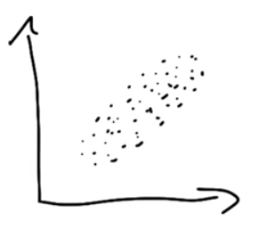
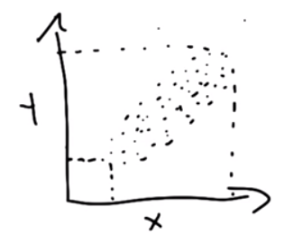
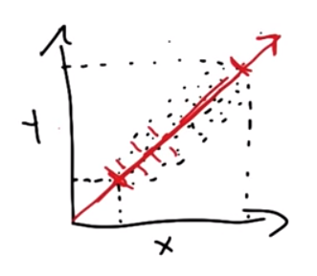
Another shot at pca …
2 dimension plot of x and y
PCA attempts to find a direction thru the points in such a way that it achieves the maximizes variance when points are projected on to that directional line or vector.
maximizes variance
Maximize variance (PC1)
Second principal component is orthogonal to the PC1 line

Slide 43
terms
Dimensionality:
It is the number of random variables in a dataset or simply the number of features, or rather more simply, the number of columns present in the dataset.
Correlation:
Shows how strongly two variables are related to each other. The value of the same ranges from -1 to +1. Positive indicates that when one variable increases, the other increases as well, while negative indicates the other decreases on increasing the former. And the modulus value of indicates the strength of relation.
Orthogonal:
Uncorrelated to each other, i.e., correlation between any pair of variables is 0.
Eigenvectors: So, consider a non-zero vector v. It is an eigenvector of a square matrix A, if Av is a scalar multiple of v. Or simply: Av = ƛv

Slide 44
goal of PCA
The overall goal of PCA is to reduce the number of d dimensions (features) in a dataset by projecting it onto a k dimensional subspace where k < d.
The approach used to complete PCA can be summarized as follows:
Standardize the data.
Use the standardized data to generate a covariance matrix (or perform Singular Vector Decomposition).
Obtain eigenvectors (principal components) and eigenvalues from the covariance matrix. Each eigenvector will have a corresponding eigenvalue.
Sort the eigenvalues in descending order.
Select the k eigenvectors with the largest eigenvalues, where k is the number of dimensions used in the new feature space (k≤d).
Construct a new matrix with the selected k eigenvectors.

Slide 45
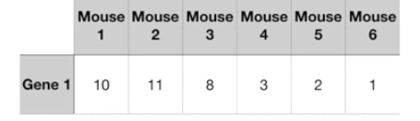

Feature extraction redundant slide
Low gene value
If we measure only 1 gene type we can plot the data on 1 dimension number line

Slide 46
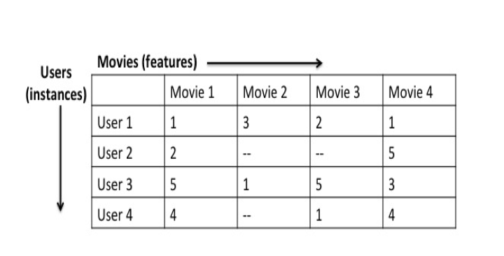
Example redundant slide
users who rank Star Wars Episode IV highly might also rank Rogue One: A Star Wars Story highly.
In other words, the ratings for Star Wars Episode IV are positively correlated with the ones for Rogue One: A Star Wars Story.
could ultimately be grouped together to form a new feature.

Slide 47
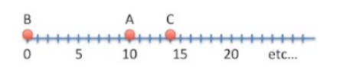
1d
Some measure | Value
A | 10
B | 0
C | 14
…
…

Slide 48
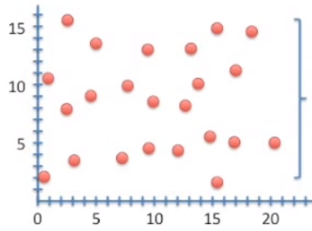
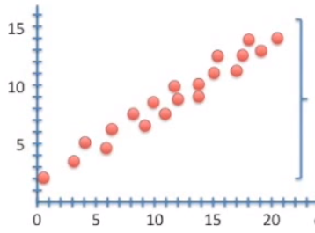
2d
Some measure | Cell 1 | Cell 2
A | 10 | 8
B | 0 | 3
C | 14 | 10
…
…
- cell1 and cell 2 are NOT correlated
- cell1 and cell 2 are correlated

Slide 49
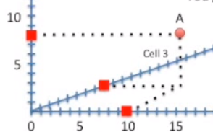
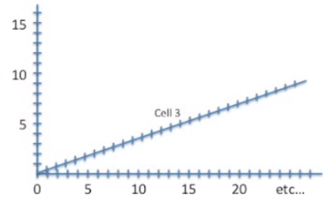
3d
Some measure | Cell 1 | Cell 2 | Cell 3
A | 10 | 8 | 8
B | 0 | 3 | 4
C | 14 | 10 | 12
…
…
Point A

Slide 50
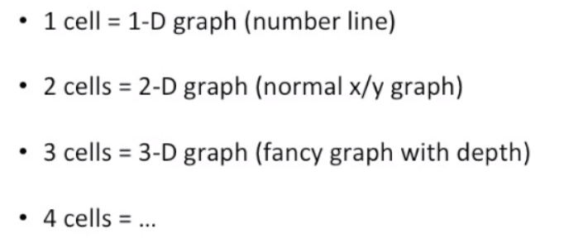

Dimensions so far
Are all these 200 dimensions important??
We cant draw that graph
No way we can draw this graph

Slide 51
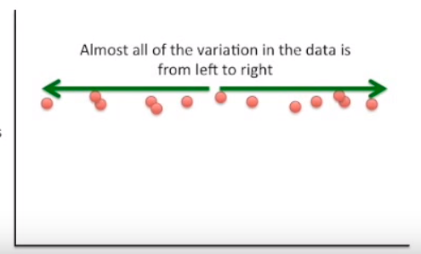
If we had 2d data like this …
Cell 1– variation at the same level
Cell 2 – variation is all – left to right
Cell 1
Cell 2

Slide 52
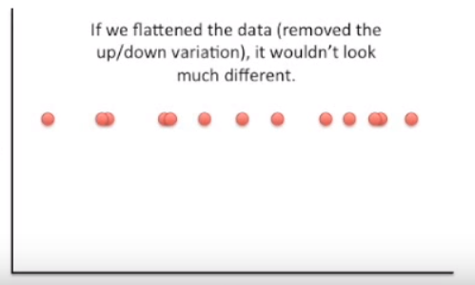
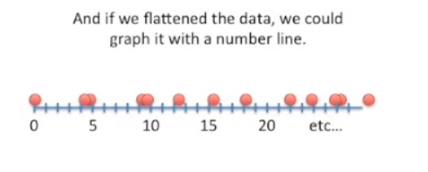
If we flatten the 2d data …
Cell 1
Cell 2

Slide 53
One more example … TV and movies …
TV and movies are almost always 2D even though the subjects are 3D !!
The 3rd dimension doesn’t usually add much to the story
The picture still look believable without the 3rd dimension!
People look like people and objects look like objects !
Even though the screen is flat !
A movie camera takes a 3D information and flattens it to 2D with out too much loss of information.

Slide 54
Summary of dimensions
Each column or cell that we add, adds another dimensions
Some dimensions are more important than others

Slide 55
What does all this have to do with pca?
PCA takes a dataset with a lot of dimensions (i.e. a lot of columns or cells) and flattens it to 2 or 3 dimensions so we can easily visualize it
PCA tries to find a meaningful way to flatten the data by focusing on the things that are different between the dimensions

Slide 56
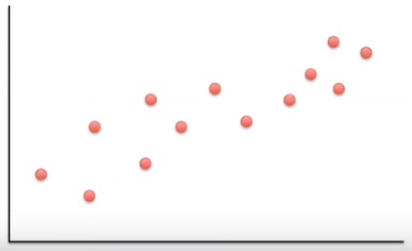
Pca example
Some measure | Cell 1 | Cell 2
A | 10 | 8
B | 0 | 3
C | 14 | 10
D | 33 | 45
E | 50 | 42
F | 80 | 72
G | 95 | 90
H | 44 | 50
I | 60 | 50
…
…
Cell 1
Cell 2
The dots are spread out along the diagonal line
Another way to think about this is that the maximum variation in the data is between the 2 endpoints of this diagonal line
Dots are also spread out also above and below the first line
Another way to think is the 2nd largest amount of variation is at the endpoints of the new line

Slide 57
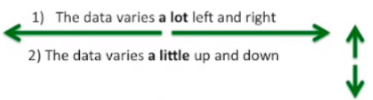
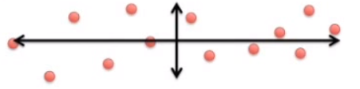
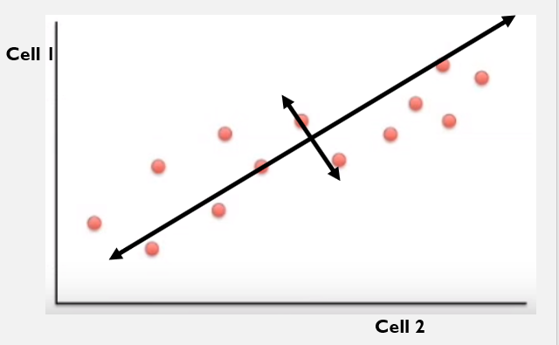
Rotate the graph …
Cell 1
The new 2 lines are the new x and y axis
This makes the left and right, above/below variation easier to see
Cell 2

Slide 58
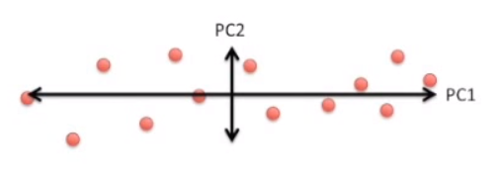
Pc1 and pc2
These 2 new (rotated) axes that describe the variation in the data are called the “PRINCIPAL COMPONENTS”
PC1 – is the axis that spans the most variation
PC2 – is the axis that spans the second most variation

Slide 59
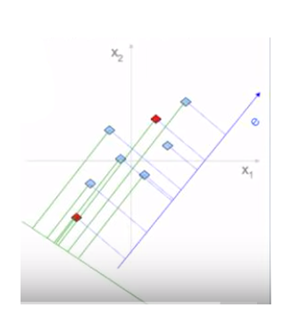
Why greatest variability
Reduce 2D data to 1D
{x1, x2} → e’ (along new axis e)
Projection done on two new axis, PC1 (blue line) and PC2 (green line)
2 RED dots on PC1 still preserves the original distance, they are almost close on PC2. Converse can be argued about BLUE dots too.
Count the pairs of DOTS and preserve the most variance (like in this case the BLUE dots (preserving distances is imp)
Pick the dimension with highest variance, that will preserve the distance
PC1
PC2

Slide 60
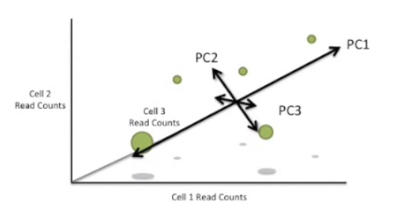
What if we had 3 cells?
PC1 – is the axis that spans the most variation
PC2 – is the axis that spans the second most variation
Since we have another dimension, we can have variation along the 3rd PC

Slide 61
What if we had n cells?
PC1 – is the axis that spans the most variation
PC2 – is the axis that spans the second most variation
PC3 – is the axis that spans the third most variation
PC4 – is the axis that spans the fourth most variation
There is PC for each dimension
If we had 200 cells, we would have 200 PCs
E.g PC200 would span the direction of 200th most variation

Slide 62

PCA approach
Step 1. Center data
Normalize –
Whole dataset without class label
subtracting the means from the numbers in the respective column.

Slide 63
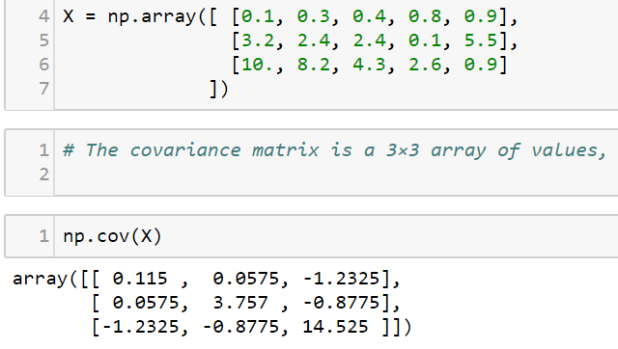


PCA approach
Step 2. Compute covariance matrix
Covariance of dimension X₁ and X₂
Observe X₁ and X₂ tend to increase together?
or does X₂ decrease as X₁ increases?

Slide 64
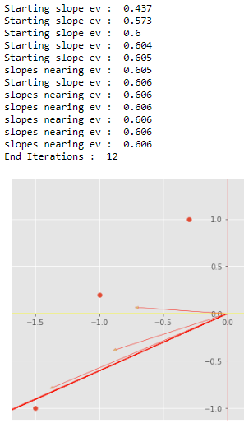
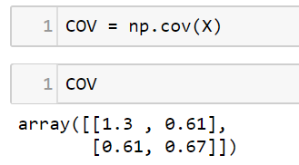
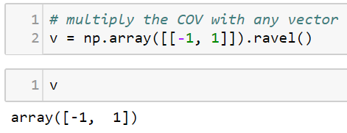
PCA approach – why COV
Step 2. Compute covariance matrix
When COV matrix is multiplied by a vector then it rotates the vector in the direction towards greatest vector
Finally all rotations will converge to a vector called ‘Eigen Vector’
X

Slide 65
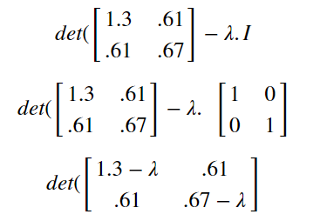
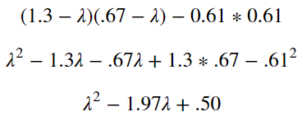
PCA approach
Step 3. Find principal components – Eigen values
Find the eigenvalues by solving: det(∑ - λ.I) = 0
There are 2 roots: {1.67, 0.30}
First PC will be the vector with biggest eigen value
Second PC will be the vector with smaller eigen value

Slide 66
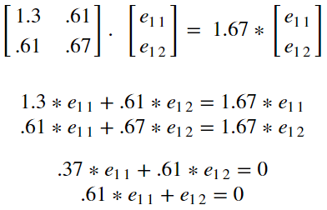
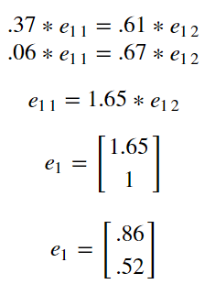
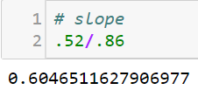
PCA approach
Step 4. Find principal components (eigen vector)
Find the i^{th} eigen vector (1st) by solving: ∑e_{i} = λ.e_{i}

Slide 67
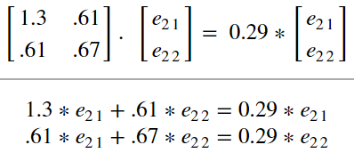
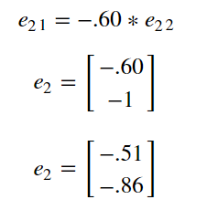
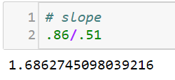
PCA approach
Step 5. Find principal components (eigen vector)
Find the i^{th} eigen vector (2nd) by solving: ∑e_{i} = λ.e_{i}

Slide 68
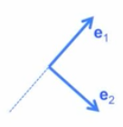
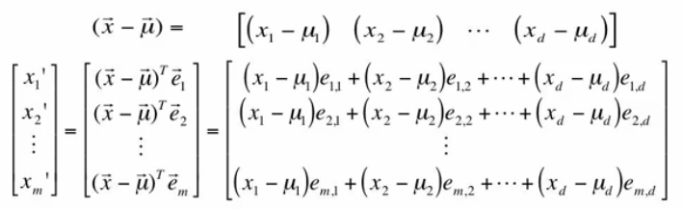
PCA approach
Step 6. Projecting Data to new dimensions
e₁, e₂ … e_{m} are the new dimension vectors
Predictors : instance X = {x₁, x₂ … x_{d}}
Calculate new coordinates x’ = {x’₁, x’₂ … x’_{d}}
Center the instance (subtract the mean) : x’ - μ
Project to each new dimension (x’ - μ)^{T} e_{j} , for j=1,2 … m}
Projection by DOT product
Transforming to LOWER dimensions

Slide 69
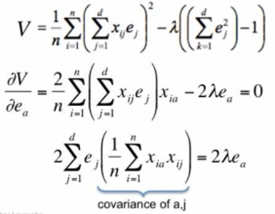
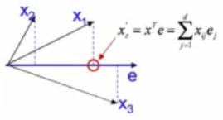

PCA approach
Step 7. Directions of greatest variability
Select dimension e which maximizes the variance
Points X_{i} projected onto vector e
Variance of projections :
Maximize variance

Slide 70
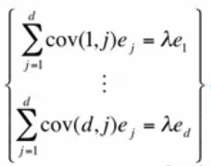
PCA approach
Step 7. Directions of greatest variability
Maximize variance
Each row of the COV is multiplied by e vector.

Slide 71
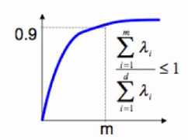
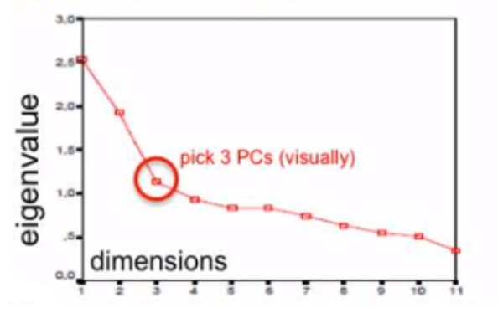
PCA approach
Step 8. How many dimensions or PCs
Eigen vectors e₁, e₂, …e_{d}
Predictors : x₁, x₂… x_{d}
Eigen values, λ_{I} = variance along the e_{i}
Pick e_{i} that explains the most variance
Pick first m eigen vectors which explain 90% or more of the total variance
Or
Use scree-plot (plot eigen values in decreasing order)

Slide 72
Pca – practical issues
PCA is based on co-variances
Covariances extremely sensitive to large values
Multiply some dimension by 1000 (constant) .. Height of people in micrometers !!!
Dominates COV
Becomes a principal component
PCA assumes underlying subspace is linear
PCA can work most of times, at some time it can really mess up
The reason is PCA does not look at the class label

Slide 73
Summarizing the PCA approach - mathematically
Take the whole dataset consisting of d-dimensional samples ignoring the class labels & Normalize the data
Compute the d-dimensional mean vector (i.e., the means for every dimension of the whole dataset)
Compute the scatter matrix (alternatively, the covariance matrix) of the whole data set
Compute eigenvectors (e₁,e₂,...,e_{d}) and corresponding eigenvalues (λ₁,λ₂,...,λ_{d})
Sort the eigenvectors by decreasing eigenvalues and choose k eigenvectors with the largest eigenvalues to form a d×k dimensional matrix W(where every column represents an eigenvector)
Use this d×k eigenvector matrix to transform the samples onto the new subspace.
This can be summarized by the mathematical equation: y=W^{T} * x (where x is a d×1-dimensional vector representing one sample, and y is the transformed k×1-dimensional sample in the new subspace.)

Slide 74
Linear discriminant analysis (lDA)
Linear Discriminant Analysis (LDA) is most commonly used as dimensionality reduction technique in the pre-processing step for pattern-classification and machine learning applications.
The goal is to project a dataset onto a lower-dimensional space with good class-separability in order avoid overfitting (“curse of dimensionality”) and also reduce computational costs.
Ronald A. Fisher formulated the Linear Discriminant in 1936
The original Linear discriminant was described for a 2-class problem, and it was then later generalized as “multi-class Linear Discriminant Analysis” or “Multiple Discriminant Analysis” by C. R. Rao in 1948

Slide 75


PCA vs. LDA
LDA | PCA
used for dimensionality reduction | used for dimensionality reduction
LDA is “supervised” | described as an “unsupervised” algorithm since it “ignores” class labels
computes the directions (“linear discriminants”) that will represent the axes that that maximize the separation between multiple classes. | goal is to find the directions (the principal components) that maximize the variance in a dataset

Slide 76
Normality assumptions
LDA as classifier | LDA for dimensionality reduction
assumes normal distributed data
features that are statistically independent
identical covariance matrices for every class

Slide 77
LDA – background
Imagine we have a drug
It works for some people
But it makes other people feel worse ☹
How do we figure out who to give the drug to?
May be patient’s gene expressions can help decide

Slide 78

Gene x
Drug works for patients with fewer transcriptions
Drug DOES NOT work for patients with fewer transcriptions

Slide 79

Gene x & y
GREEN dots indicate drug works
RED dot indicate the drug does not work
A line separating the two classes, does the good job of separating the 2 classes
Still there are chances of misclassification.
Should we try 3 genes ?

Slide 80

Gene x, y & z
With 3 dimensions, we use a plane to try and separate the 2 classes
What if we need 4 or more genes to separate the 2 classes?
We cant draw 4D or 100D graph
Same issue we faced in PCA
PCA reduces dimensions by focusing on the gene with the most variation
But we aren’t interested in genes with most variation. Rather on max separability between the classes
LDA is like PCA, but focusses on maximizing the separability among the classes

Slide 81

Example
Convert 2D graph to 1D graph so that it gives maximum separability to the classes.
What’s the way to do it?

Slide 82

Reducing 2D to 1D
One way would be to ignore Gene Y and project Gene X on to the X axis
But we lose useful information in Gene Y

Slide 83


How LDA does it?
LDA uses information from both the classes to maximize the separation of 2 classes
LDA creates a new axis
2 criteria used
Maximize the distance between the means
Minimize the variation (scatter) within each class

Slide 84



Distance between the means and scatter
If we only maximize the distance …
There is overlap in the middle
This isn’t good separation
But we minimize the scatter, there is better separability

Slide 85
PCA vs LDA: What to Choose for Dimensionality Reduction?
In case of uniformly distributed data, LDA almost always performs better than PCA.
However if the data is highly skewed (irregularly distributed) then it is advised to use PCA since LDA can be biased towards the majority class.
it is beneficial that PCA can be applied to labeled as well as unlabeled data since it doesn't rely on the output labels !!!
On the other hand, LDA requires output classes for finding linear discriminants and hence requires labeled data.

Slide 86
LDA in 5 steps
Step 1: Computing the d-dimensional mean vectors
In this first step, we will start off with a simple computation of the mean vectors m_{i} (i=1, 2, 3) of the 3 different flower classes

Slide 87
Feature engg – imp aspects
Missing Values
find features with a fraction of missing values above a specified threshold.
Collinear Features
Collinear features are features that are highly correlated with one another. In machine learning, these lead to decreased generalization performance on the test set due to high variance and less model interpretability.
Zero/low Importance Features
only for supervised machine learning problems where we have labels for training a model and is non-deterministic.
use feature importance for feature selection by removing zero importance features. In a tree-based model, the features with zero importance are not used to split any nodes, and so we can remove them without affecting model performance.
Single Unique Value Features
A feature with only one unique value cannot be useful for machine learning because this feature has zero variance. For example, a tree-based model can never make a split on a feature with only one value (since there are no groups to divide the observations into).

Slide 88
Techniques for Data Dimensionality Reduction
Missing Values Ratio.
Data columns with too many missing values are unlikely to carry much useful information.
Thus data columns with number of missing values greater than a given threshold can be removed.
The higher the threshold, the more aggressive the reduction.

Slide 89
Techniques for Data Dimensionality Reduction
Low Variance Filter.
data columns with little changes in the data carry little information.
Thus all data columns with variance lower than a given threshold are removed.
A word of caution: variance is range dependent; therefore normalization is required before applying this technique.

Slide 90
Techniques for Data Dimensionality Reduction
High Correlation Filter.
Data columns with very similar trends are also likely to carry very similar information.
In this case, only one of them will suffice to feed the machine learning model.
Here we calculate the correlation coefficient between numerical columns and between nominal columns as the Pearson’s Product Moment Coefficient and the Pearson's chi square value respectively.
Pairs of columns with correlation coefficient higher than a threshold are reduced to only one.
A word of caution: correlation is scale sensitive; therefore column normalization is required for a meaningful correlation comparison.

Slide 91
Techniques for Data Dimensionality Reduction
Random Forests / Ensemble Trees.
Decision Tree Ensembles, also referred to as random forests, are useful for feature selection in addition to being effective classifiers.
One approach to dimensionality reduction is to generate a large and carefully constructed set of trees against a target attribute and then use each attribute’s usage statistics to find the most informative subset of features.

Slide 92
Techniques for Data Dimensionality Reduction
Principal Component Analysis (PCA).
Principal Component Analysis (PCA) is a statistical procedure that orthogonally transforms the original n coordinates of a data set into a new set of n coordinates called principal components. As a result of the transformation, the first principal component has the largest possible variance; each succeeding component has the highest possible variance under the constraint that it is orthogonal to (i.e., uncorrelated with) the preceding components. Keeping only the first m < n components reduces the data dimensionality while retaining most of the data information, i.e. the variation in the data. Notice that the PCA transformation is sensitive to the relative scaling of the original variables. Data column ranges need to be normalized before applying PCA. Also notice that the new coordinates (PCs) are not real system-produced variables anymore. Applying PCA to your data set loses its interpretability. If interpretability of the results is important for your analysis, PCA is not the transformation for your project.

Slide 93
SINGULAR VALUE DECOMPOSITION FOR PREDICTIVE ANALYTICS
Singular Value Decomposition(SVD) is one of the most widely used Unsupervised learning algorithms, that is at the center of many
recommendations and
Dimensionality reduction systems
global companies such as Google, Netflix, Facebook, Youtube, and others.

Slide 94
SINGULAR VALUE DECOMPOSITION
Singular value decomposition (SVD) represents a dataset by eliminating the less important parts and generating an accurate approximation of the original dataset.
In this regard, SVD and PCA are methods of dimensionality reduction.
SVD will take a matrix as an input and decompose it into a product of 3 simpler matrices.
An m by n matrix M can be represented as a product of three other matrices as follows:
M = U * S * V ^{T}
Where U is an m by r matrix, V is an n by r matrix, and S is an r by r matrix; where r is the rank of the matrix M.

